Slide 1

Policy for the Approval or Revision of Academic Programs and Organizational Units
Training Session – Spring 2026

Slide 2
Agenda
ADHE Structure and Purpose
Degree Information and Approved Lists
Academic Program Development & Change
  Letter of Intent
  Program Proposals
  Letter of Notification
  Certificate and Degree Definitions
Best Practices
Scenarios

Slide 3
Arkansas Division of
Higher Education
Structure and Purpose

Slide 4


ADHE Structure and Purpose
ARKANSAS DEPARTMENT OF EDUCATION
Elementary & Secondary Education
Career & Technical Education
Arkansas State Library
Schools for The Deaf & The Blind
MLK Jr. Commission & Board
Higher Education
Notes:
The Arkansas Department of Education is the agency with oversight over all education in the state, including K-12 education, higher education, and career and technical education.

Slide 5
ADHE Structure and Purpose
ARKANSAS HIGHER EDUCATION COORDINATING BOARD
(AHECB)
7 members appointed by the Governor and serve staggered six-year terms
The AHECB is charged by state law to coordinate higher education in Arkansas and to assure an orderly and effective development of each of the publicly supported institutions of higher education. ADHE serves as the administrative staff of the AHECB.

Slide 6

ADHE Structure and Purpose
DIVISION OF HIGHER EDUCATION
Academic Affairs
Institutional Finance
Financial Aid
Operations
Data Team
Career Pathways Initiative
SAA for Veterans Training
Carl D. Perkins
EngageAR

Slide 7
Degree Information
and
Approval Lists

Slide 8
Degree Information & Approval Lists
The following lists can be found on ADHE’s website and should be referenced when working in this policy.
AHECB Approved Degree Programs | AHECB Approved Graduate Programs
AHECB Approved List by Distance | AHECB Approved Concentrations
AHECB Approved Concurrent Contacts | Assigned Degree Codes for Private & Nursing Institutions
AHECB Approved Department Codes | AHECB Approved Degree Programs (Excel Format)

Slide 9
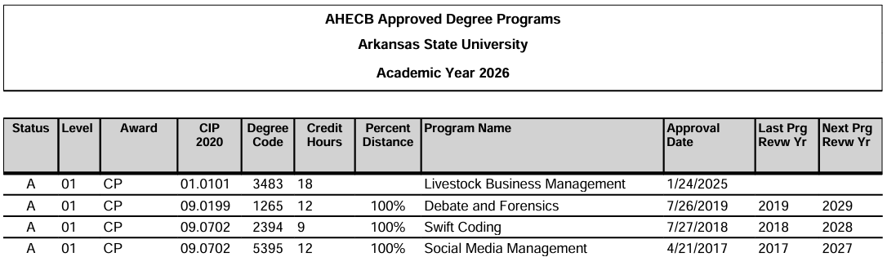
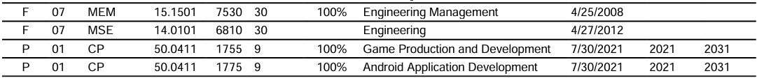
Degree Information & Approval Lists
AHECB Approved Degree Programs List

Slide 10
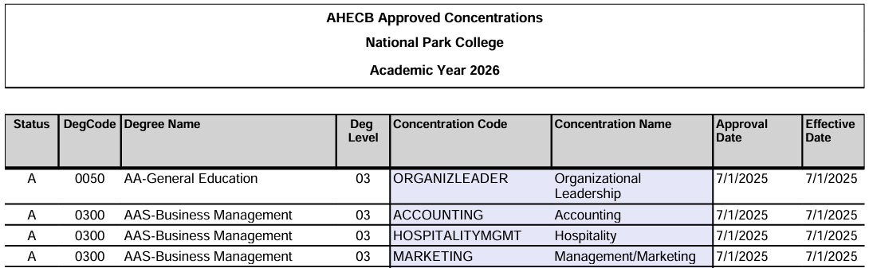
Degree Information & Approval Lists
AHECB Approved Concentrations List

Slide 11
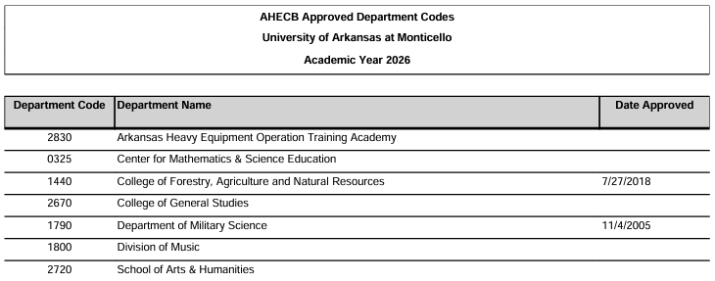
Degree Information & Approval Lists
AHECB Approved Department Code List

Slide 12
Degree Information & Approval Lists
Definitions of approved certificates and degree types can be found in
Appendix B of the policy.
Definitions include
Purpose
Credit hour ranges and/or limits
Curriculum requirements
Prior external approvals – teacher licensure, nursing, etc.
Any deviation from an approved definition must be approved.

Slide 13
Academic Program
Development and Change

Slide 14
Academic Program Development & Change
Important Webpages
ADHE Academic Affairs
Academic Program Development & Change
(includes links to policy, forms, templates, information, and guidance)
ADHE File Transfer System

Slide 15

Academic Program Development & Change
Approval Types
Requires ADHE Commissioner Approval
Requires AHECB Approval
Notes:
This policy is broken down into 2 categories: development or changes that require AHECB approval and those that require ADHE Commissioner approval.

Slide 16
Academic Program Development & Change
AHECB Approval Required
The creation of a new certificate or degree program, regardless of mode of instruction, where 25% or more of a degree program or 50% or more of a certificate program is new coursework.
The establishment of new organizational units that serve as a base for faculty appointments or offer degree programs.
Process Overview
Letter of
Intent
Program Proposal
AHECB
Vote

Slide 17
Academic Program Development & Change
A Letter of Intent (LOI) informs the Coordinating Board of an institution’s intent to create a new academic program or organizational unit.
Initial step in the process to create a new program or organizational unit
Form is submitted to ADHE and requires an email notification to all CAOs (See form for email details)
Intent is presented to the AHECB via the quarterly Letter of Intent agenda item
Valid for one year
Initiates the generation of a LMI report to be used in the writing of the proposal
Letter of
Intent
Ooooo tell me more…

Slide 18
Academic Program Development & Change
ADHE uses Lightcast to create a Workforce Analysis Report to be used when writing a program proposal. On the LOI form, the following must be provided.
Proposed 6-digit CIP code
Relevant SOC codes
Relevant NAICS codes
Possible Occupation titles
Employment regions (cities, counties, states, MSAs)
This report provides a strong foundation for all institutions, regardless of their size or available resources. While it should be included in a proposal’s workforce analysis; it should not be the sole source of information.
We even do ad hoc workforce analysis reports!
Letter of
Intent

Slide 19
Academic Program Development & Change
Deadlines for Letters of Intent
Letters of Intent are due on the first business day of the month of the scheduled AHECB meeting. Letters of Intent to create a new program must be presented at least one AHECB meeting prior to the presentation of the proposal. Comments or objections to a Letter of Intent must be submitted in writing to ADHE and submitting institution within 30 days of the email to all Arkansas public institutions.
Letter of
Intent
Letter of Intent
AHECB Meeting | Deadline
January | January 1
April | April 1
July | July 1
October | October 1

Slide 20
Academic Program Development & Change
A Program Proposal outlines the detailed information about the new program or unit’s purpose, goals, curriculum, resources, and funding.
Second step in the process to create a new program or organizational unit
Form submitted to ADHE for review and summary
Requires the institution’s Board of Trustees approval prior to consideration by the AHECB
Presented to the AHECB within one year following the Letter of Intent, but not concurrently
Program
Proposal

Slide 21
Academic Program Development & Change
Deadlines for Program Proposals
Proposals are due on the first business day of the month, two months prior to the scheduled AHECB meeting. Program proposal summaries are available on the ADHE website.
Program
Proposal
Program Proposal
AHECB Meeting | Deadline
January | November 1
April | February 1
July | May 1
October | August 1

Slide 22
Academic Program Development & Change
After a Program Proposal is reviewed and summarized, it is placed on the AHECB agenda as a voting item.
Final step in the process to create a new program or organizational unit
Proposal summary is presented to the Board by the ADHE Assistant Commissioner for Academic Affairs
Institutional representatives must attend the AHECB meeting to respond to questions about their proposed new program or unit.
Institutions must initiate programs or units by the dates listed in the Board agenda item. AHECB approval terminates if not initiated within two years
AHECB
Vote

Slide 23
Academic Program Development & Change
ADHE Commissioner Approval Required
Programmatic, organizational, and location changes requiring Commissioner approval fall into 3 categories detailed by 17 distinct conditions, as outlined in the policy.
Modification of existing programs or units
Creation of new certificates or degrees made of mostly existing coursework and within policy thresholds.
Creation of new organizational units or off-campus locations, including concurrent education

Slide 24
Academic Program Development & Change
Process Overview
Letter of
Notification
ADHE Review
AHECB
Agenda
A Letter of Notification (LON) notifies the Coordinating Board of proposed revisions to previously approved programs or units, or the creation of new programs or units based on existing approvals.
Form is submitted to ADHE with required documentation attached
ADHE reviews and evaluates the request, then compiles into an agenda item listing
Prior to finalization, agenda item listings are sent to the institution’s CAO for review and approval
All LON agenda item listings are consolidated and placed on the AHECB agenda as single consent item, requiring no vote

Slide 25
Academic Program Development & Change
When to Use an LON
Program Development
Creation of a new certificate where less than 50% of the curriculum is new coursework
Creation of a new degree where less than 25% of the curriculum is new coursework
Creation of a concentration
Creation of a minor
Requirements for specific certificate and degree award types are listed in the policy.
Letter of
Notification

Slide 26
Academic Program Development & Change
When to Use an LON
Changes to Existing Certificates or Degrees
Change the title
Change the CIP Code
Offered via distance education
Offered at an existing off-campus location
Revise the curriculum
  An LON is only required when an institution makes a change of 25% or more of a degree program or 50% or more of a certificate program.
  If revisions affect information on the Approved Programs List, an LON is required regardless of the percent of change.
Letter of
Notification

Slide 27
Academic Program Development & Change
When to Use an LON
Deletions
Delete a certificate, degree, concentration, or minor
Requires teach-out plan
The effective date should reflect when the teach-out begins, not the projected date when enrollment reaches zero
Status will change from A=Active to P=Phase-Out until enrollment is zero. The status will then change again to D=Delete and be removed from the Approved Programs List
Letter of
Notification

Slide 28
Academic Program Development & Change
When to Use an LON
Inactivations
Inactivate a certificate or degree program
  Does not apply to a concentration under a certificate or degree program
The effective date should reflect when the teach-out begins, not the projected date when enrollment reaches zero
Status will change from A=Active to F=Future Inactive until enrollment is zero. The status will then change again to I=Inactive
Programs in Inactive status for longer than 5 years will be deleted.
Letter of
Notification

Slide 29
Academic Program Development & Change
When to Use an LON
Reactivations
Applies to certificate or degree programs previously inactivated
Institutions are given 2 options
  Reactivate and maintain previous program review and viability standards OR
  Reactivate and reset or extend program review and viability standards
Letter of
Notification

Slide 30
Academic Program Development & Change
When to Use an LON
Instruction, Research, or Service Centers including Concurrent
Create new center fully supported by sources other than state funds
  Must provide list of initial program(s) offered, include CIP & degree code
New off-campus location including Concurrent Education Partners
  Requires email notification to all CAOs
  Must provide list of initial program(s) offered, include CIP & degree code
  Must follow all ADHE Concurrent Education policies & procedures
Deletion of an Instruction, Research, or Service Center
Letter of
Notification

Slide 31
Academic Program Development & Change
When to Use an LON
Organizational Units
Create units not serving as a base for faculty appointments or degree programs
Reorganize existing organizational units
  Combine or separate
  Change the title
  Delete an organizational unit
Letter of
Notification

Slide 32
Academic Program Development & Change
Deadlines for Letters of Notification
Letters of Notification are due on the first business day of the month, two months prior to the scheduled AHECB meeting.
Letter of
Notification
Letter of Notification
AHECB Meeting | Deadline
January | November 1
April | February 1
July | May 1
October | August 1

Slide 33
Best Practices

Slide 34
Best Practices: General
Form Completion & Submission
Up-to-date version available on ADHE website
Intended to be completed and signed digitally, not printed and scanned
  Tip: Most digital signatures will lock pdfs and prevent them from being edited. Get your CAO’s digital signature last.
Enable Java, if prompted
Board of Trustees approval/notification date must be prior to the AHECB meeting date
Required supporting documents should be attached to form (Demo video)
When submitting more than one form, please do not combine as one large file.
Uploaded to the File Transfer System into appropriate folder

Slide 35
What would you do, Tracy?
When completing the LOI or LON form, I would complete it in this order (if possible)
Download latest version from ADHE’s website.
Save it on my computer using a naming convention that is informative and includes my institution’s abbreviation, award type, program name, etc.
Ex. LON ASU BS Exercise Science Revision
At the top of the form, select my institution and complete the remaining institutional information skipping the signature (for now).
If you are unsure of the President/Chancellor Approval Date or the BOT Approval/Notification Date, please do not skip it. Ask your CAO to complete this information when they add their signature.
Complete the required information in the appropriate category.
Attach required documentation.
Save!
Send to your CAO for their digital signature (this will lock the form from edits).
The CAO/AA staff will submit to ADHE via the File Transfer System.

Slide 36
Best Practices: Letter of Intent
Send LOIs early!
  LOI indicates intent to develop, it does not obligate the institution to create the credential
  LOI will allow the institution to collect valuable feedback to better contribute to substance, details, or depth to a proposal
All workforce analysis fields are necessary for ADHE to create a meaningful report required in program proposals.
  Partial CIP and SOC codes will not be accepted.

Slide 37
Best Practices: Proposal
Should be written as though this is your 15 minutes of fame!
The Board’s first impression of your program will be from reading the summary prepared by ADHE Academic Affairs staff. The summary of the program is only as good as the information provided in the proposal.
Please use AI (LLM) responsibly and ensure content has been thoroughly reviewed for accuracy and relevance. It is good practice to cite when AI has been used.
Program advisory committees should be formed and have met prior to proposal submission.
ADHE Academic Affairs Staff are willing to review and provide feedback on draft proposals before formal submission.
  Because each program and proposal has unique features and elements, we would encourage you to seek guidance and feedback early and often.

Slide 38
Best Practices: Letter of Notification
Email notifications are not required for LONs except for Category 6, adding a New Off-Campus Location for Concurrent Education.
For similar programs, multiple categories can be completed on the same LON form
Form fields should be completed based on the information listed on the AHECB Approval Lists.
  Access these lists directly from our website. Googling will result in old versions!
  Discrepancies between AHECB and institutional information are common. Contact us for guidance on how to resolve these differences.
If a program is not approved to be offered online, a concentration under this parent program cannot be offered online. It is package deal…online approval must be obtained for the parent program first.

Slide 39
Best Practices: Letter of Notification
Effective Dates are very important!
  Directly affects a program’s status and how it appears on the Approval Lists
    Statuses exist to accommodate for phase-out and teach-out plans.
  Determines a program’s starting and ending dates
  Has a direct impact on program viability & program review.

Slide 40

SHALL WE PLAY A GAME?

Slide 41

Our college’s Art Department is interested in creating a Certificate of Proficiency in Graphic Design. Many faculty have begun developing new courses that will comprise 12 hours of the total 15 credit hours.
Answer is in slide notes below.
Notes:
Since 12 out of the 15 credit hours, or 80%, of the CP’s courses will be new coursework, creating this CP will require a Letter of Intent and Program Proposal.

Slide 42
A high school contacted us about offering our certificate programs in welding and construction technology to their students. We are excited for this opportunity since we haven’t offered courses to these students before!
Answer is in slide notes below.
Notes:
To offer programs under a MOU with a new concurrent education partner, the institution would submit an LON and send an email to all AR public CAOs notifying them of this new partnership.
Note: Institutions are also required to follow all other Concurrent Education policies and procedures.

Slide 43
Our Bachelor of Science in Computer Science degree has some outdated courses in the curriculum. We would like to remove twelve credit hours and replace them with 4 new courses in Artificial Intelligence.
Answer is in slide notes below.
Notes:
By definition, a bachelor’s degree is a minimum of 120 credit hours. Twelve credit hours, or 4 courses, comprises only 10% of the program’s curriculum. Notification of curriculum change for a bachelor’s degree would be required at 25% change. In addition, 12 credit hours is being replaced by 12 credit hours, therefore, the total hours on the Approved Programs List is not being affected. No notification to ADHE is required.

Slide 44
My institution has an Associate of Science in Agriculture degree which is currently 60 credit hours. We need to add American Government to the degree plan to comply with Act 566, which will increase the credit hours to 63.
Notes:
This one is tricky. While we have said we will not require LONs to adjust curriculum to comply with Act 566 (Requisite Core), this scenario added a course to an existing degree plan instead of a course-replacement scenario most institutions are adopting. Since this course addition alters the total credit hours, an LON would need to be submitted to update the Approved Programs List.

Slide 45
Our institution recently reviewed both the Bachelor of Science in Education in Mathematics Education and the Bachelor of Science in Education in Science Education programs. The Dean would like to combine these two degrees to create a Bachelor of Science in Education in STEM. The proposed changes have been sent to DESE, but approval has not been received.
Notes:
This is also another tricky scenario. Policy does allow for the combining of previously approved programs to create a new program, which would require an LON. In this scenario, the institution would not only need to submit the LON to ADHE, but they would also need to receive approval from ADE’s Division of Elementary and Secondary Education before the LON will be added to the AHECB agenda.

Slide 46
Open Discussion

Slide 47


We make “house” calls!
We are available to offer training on your campus as a workshop, presentation, or in other formats.
Groups that may benefit are
Curriculum Council or Committees
Deans, Program Chairs, or other campus leaders
Academic Affairs staff
If you are interested, contact us to set up a Zoom or call to discuss the needs of your institution or program. We can then customize this training and guidance to suit your needs.
Tracy Harrell
Tracy.Harrell@adhe.edu (501) 371-2058
Mason Campbell
Mason.Campbell@adhe.edu (501) 371-2044

